Slide 1

T20 SQL Project

Slide 2
Batting Performance Analysis
Which batsman scored the highest runs in a match?
What is the average strike rate of batsmen in a given match?
How many batsmen had a strike rate above 150 in a match?
Who faced the most number of balls in a single match?
Which batsman hit the most sixes in a match?
How many batsmen remained not out in a match?
Which batting position had the highest average score?
What is the total number of boundaries (fours and sixes) hit by each team in a match?
What is the average runs per over for a team in a given match?
How many batsmen scored more than 30 runs in a single match?

Slide 3
Bowling Performance Analysis
Which bowler took the most wickets in a match?
What is the economy rate of each bowler in a match?
Which bowler bowled the highest number of dot balls in a match?
How many bowlers conceded more than 40 runs in a match?
Which bowler had the best bowling average in a match?
Who bowled the most maiden overs in a match?
Which bowler had the lowest economy rate in a match?
Match & Team Performance Analysis
Which team won the most matches in a given tournament?
What is the highest margin of victory in the dataset?
How many matches were won by a margin of fewer than 10 runs or 2 wickets?

Slide 4
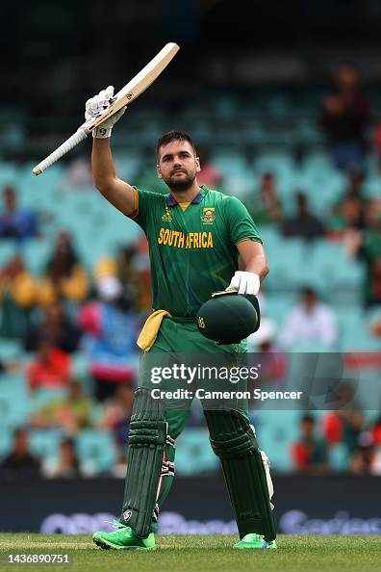
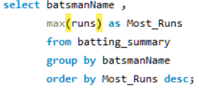
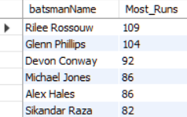
1.Which batsman scored the highest runs in a match?

Slide 5
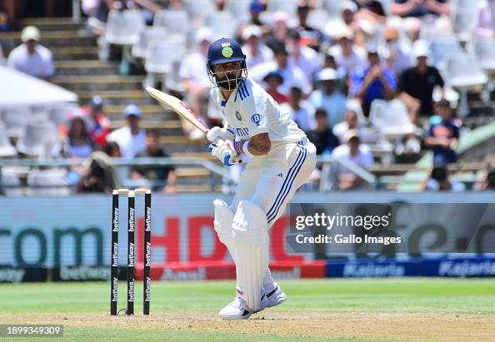
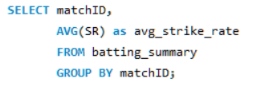
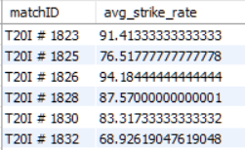
2. Average strike rate of batsmen in a given match

Slide 6
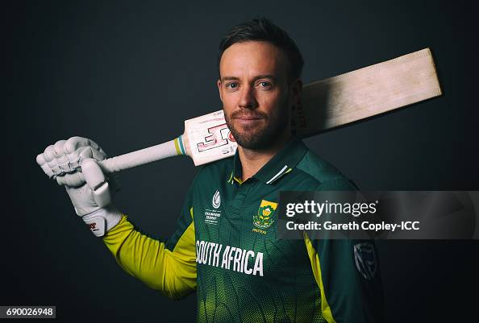
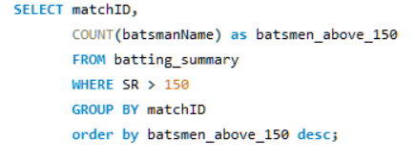
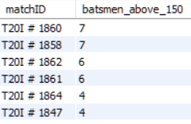
3. Number of batsmen with strike rate above 150 in a match ?

Slide 7
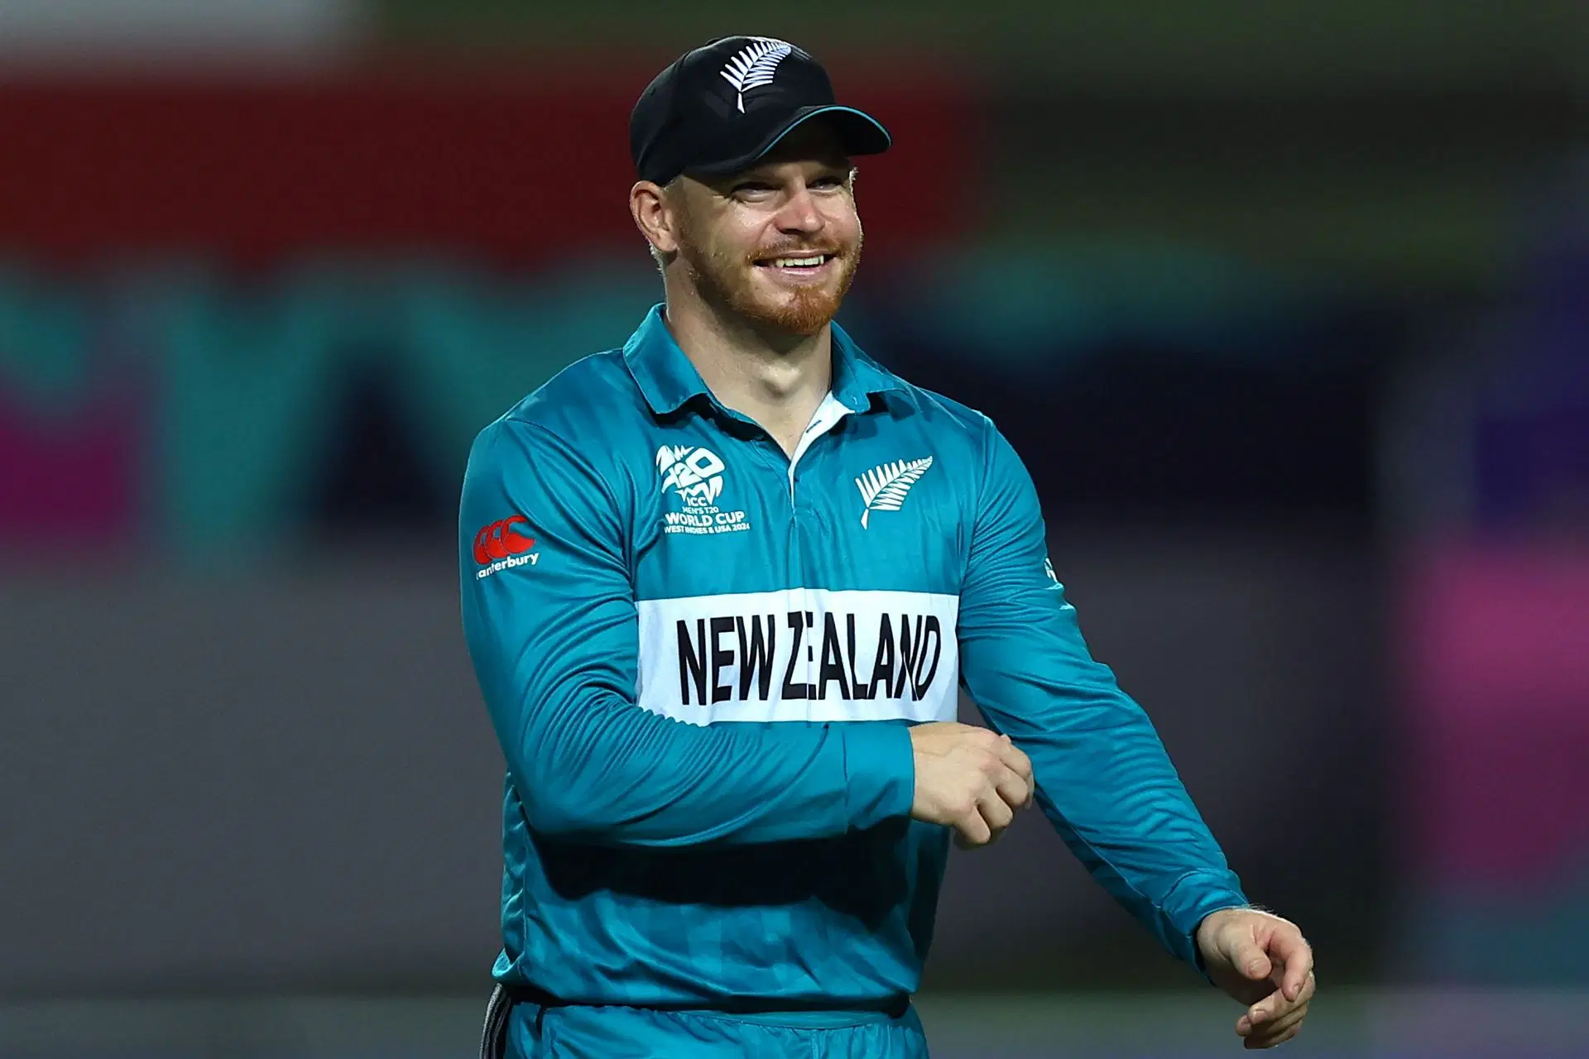
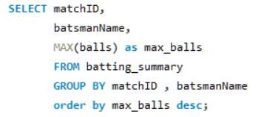
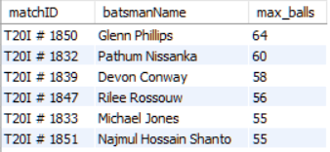
4. Batsman who faced the most balls in a single match

Slide 8
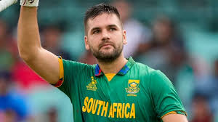
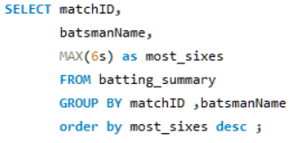
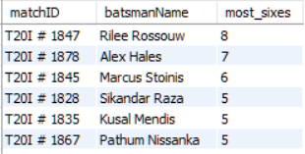
5. Batsman who hit the most sixes in a match

Slide 9
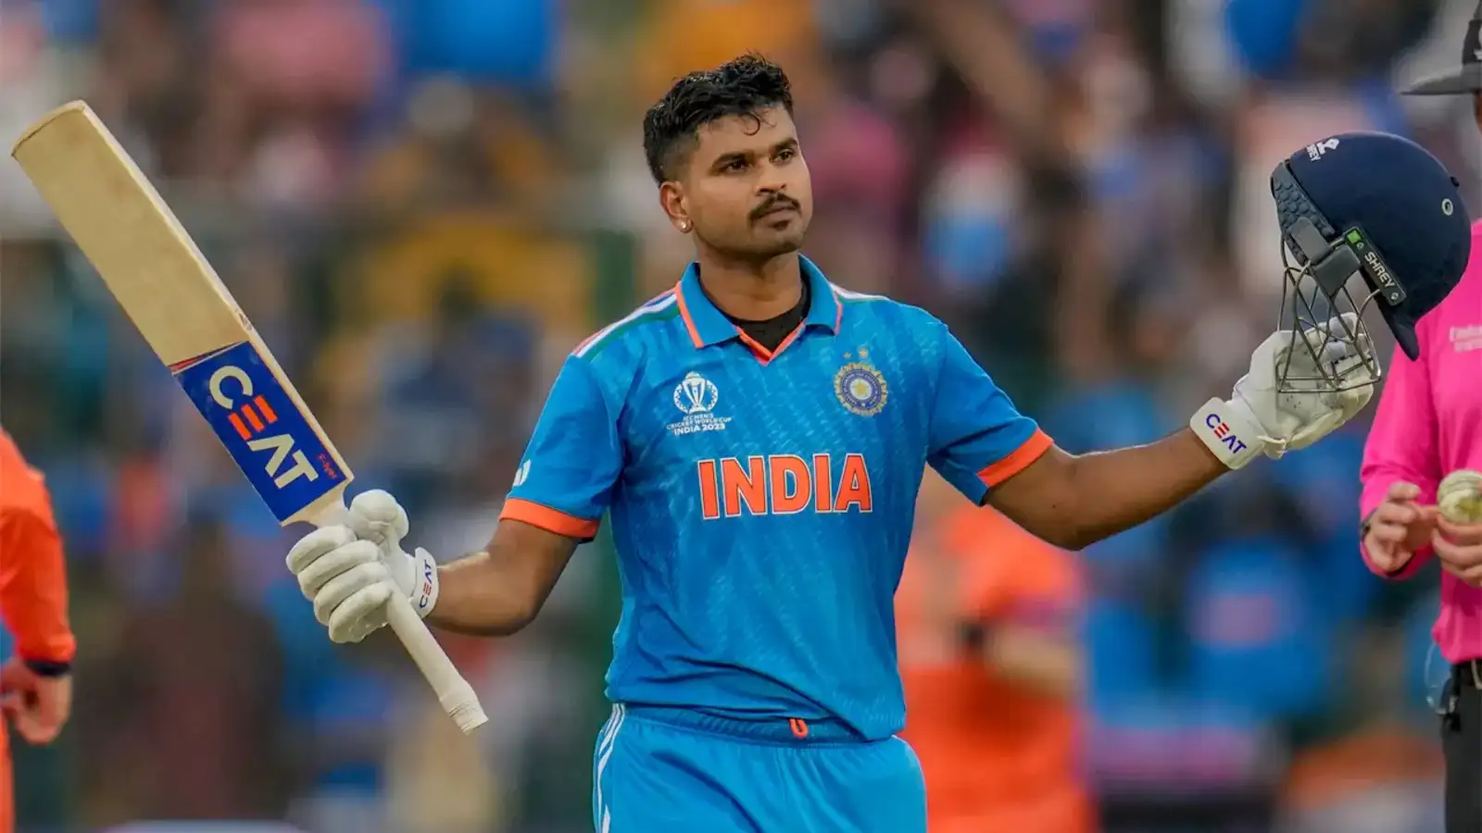
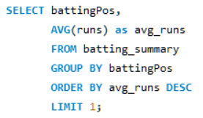
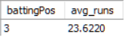
7. Batting position with highest average score

Slide 10
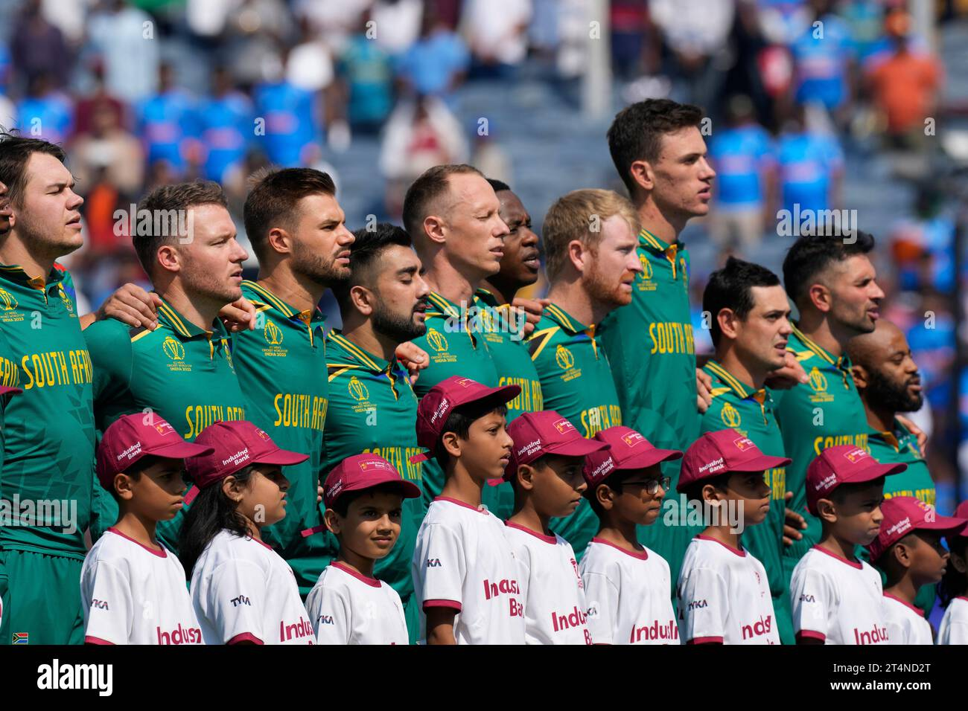
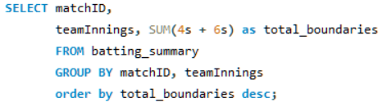
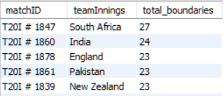
8. Total number of boundaries (fours and sixes) hit by each team in a match ?

Slide 11
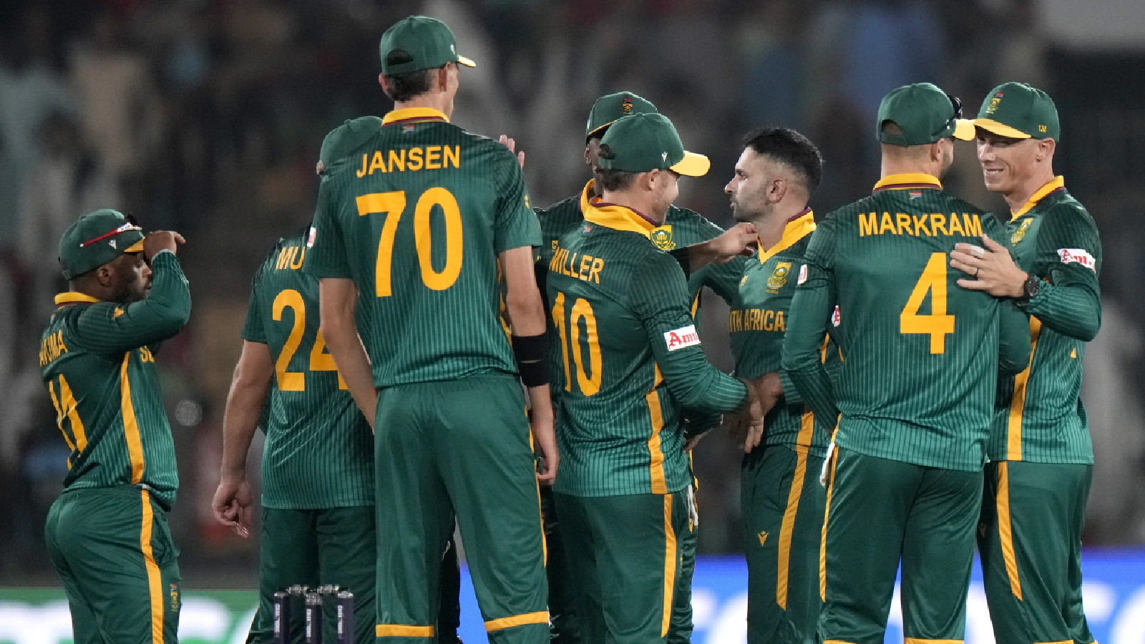
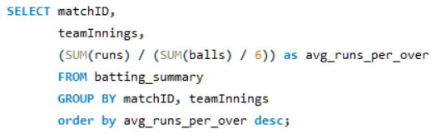
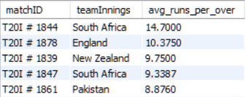
9. Average runs per over for a team in a match

Slide 12
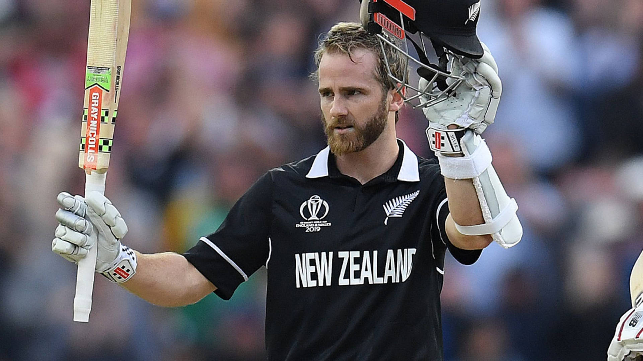
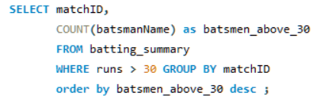
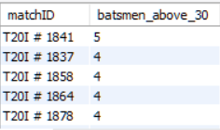
10. Number of batsmen who scored more than 30 runs in a match

Slide 13
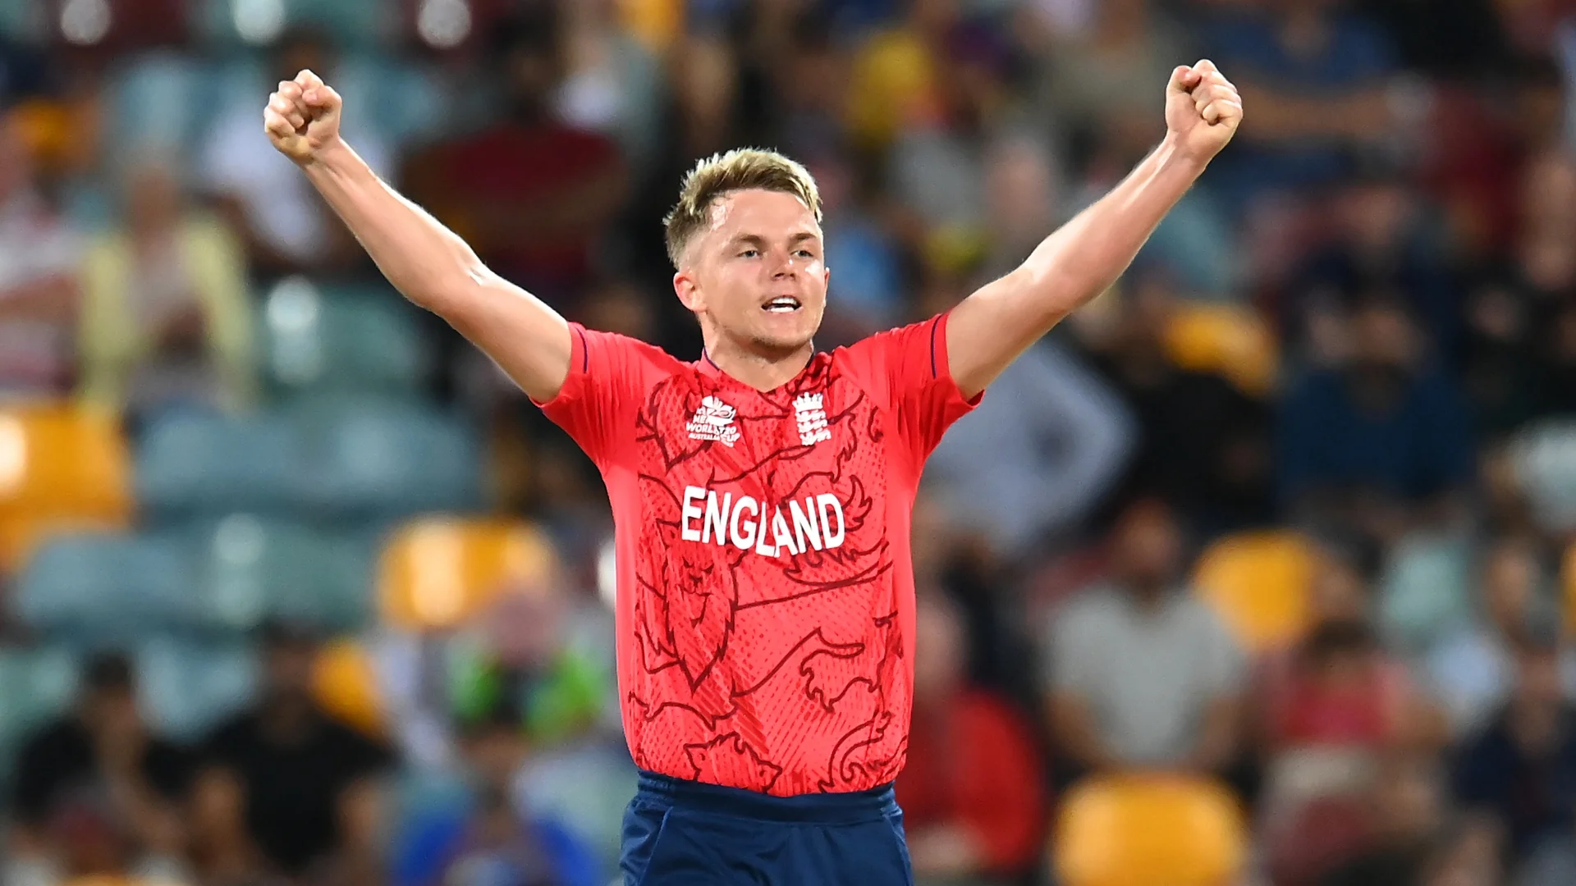
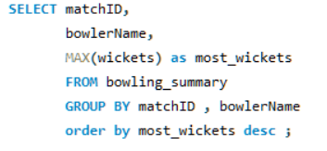
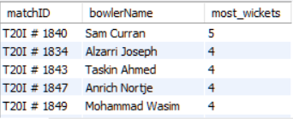
11. Bowler who took the most wickets in a match

Slide 14
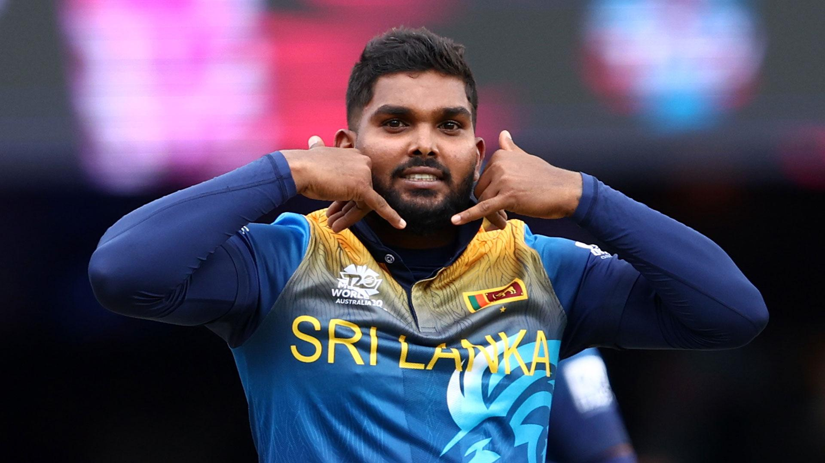
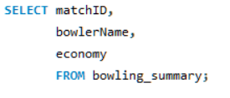
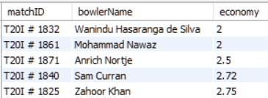
12. Economy rate of each bowler in a match

Slide 15
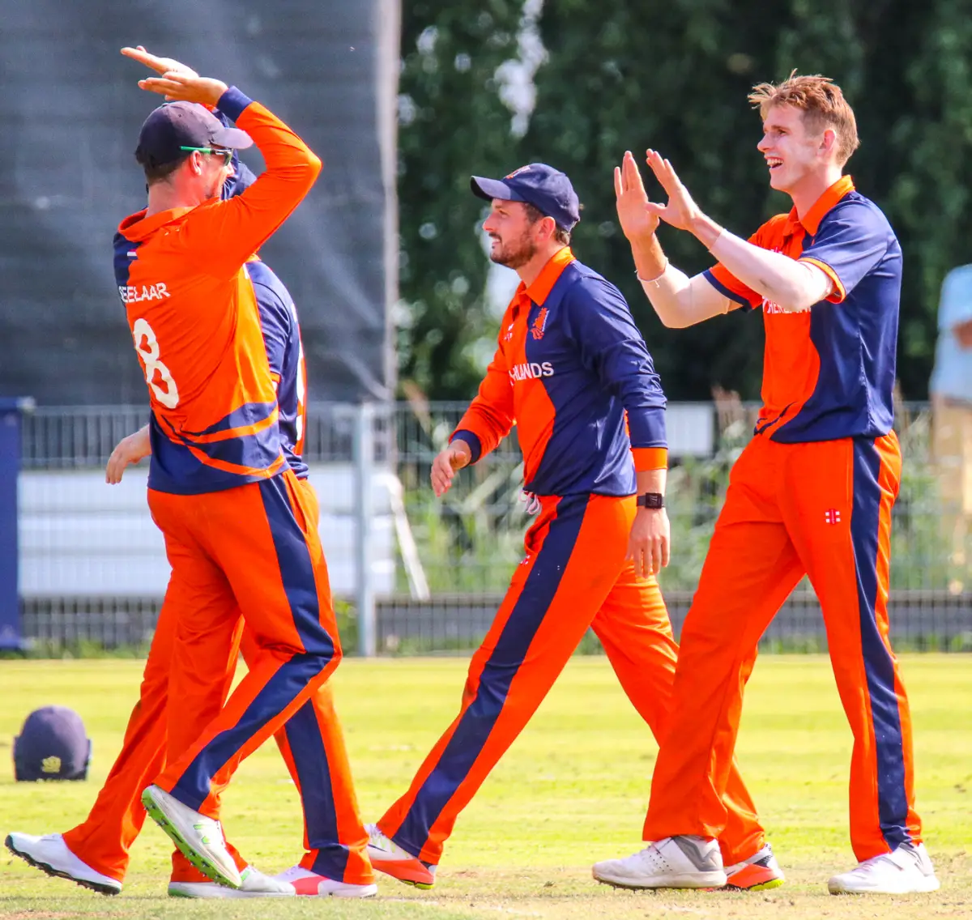
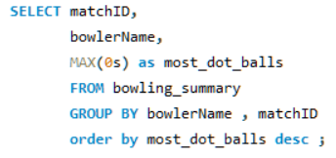
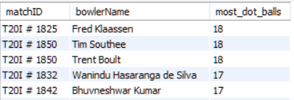
13. Bowler with the highest number of dot balls in a match

Slide 16

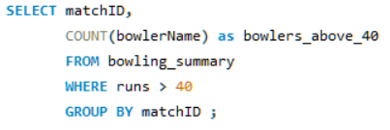
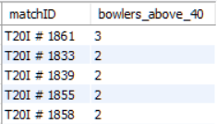

Slide 17
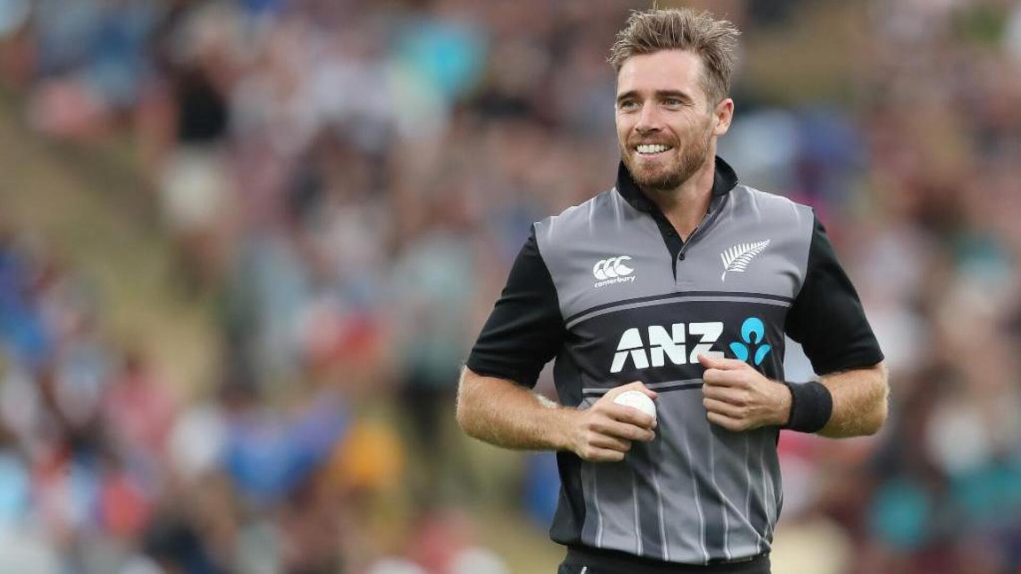
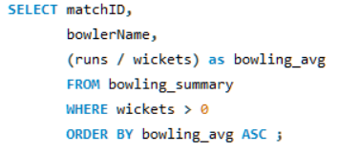
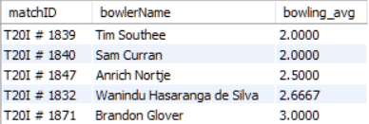
15. Bowlers with the best bowling average in a match

Slide 18
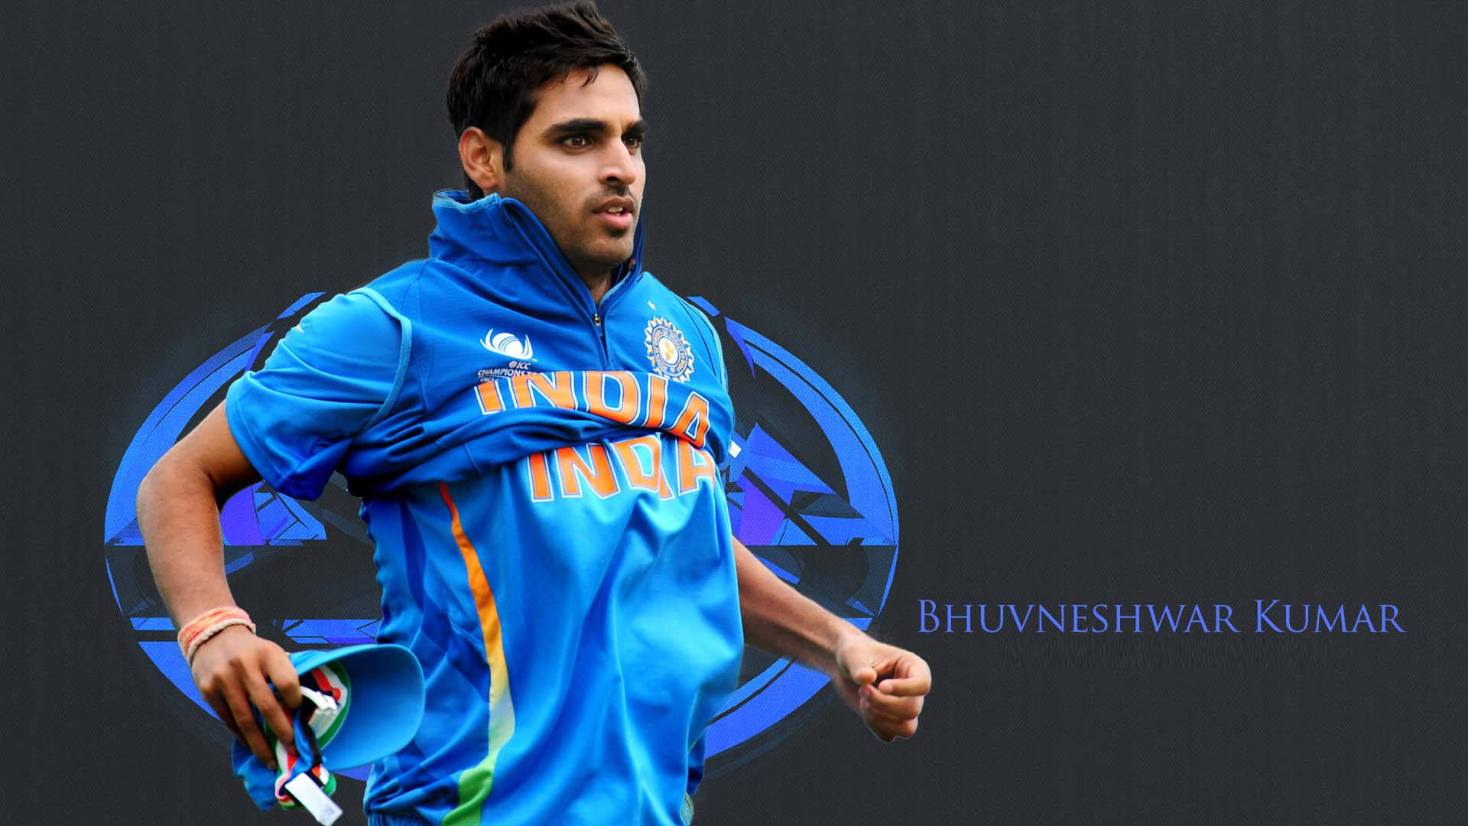
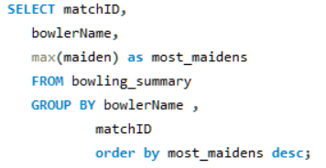
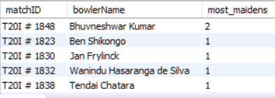
16. Bowler who bowled the most maiden overs in a match

Slide 19
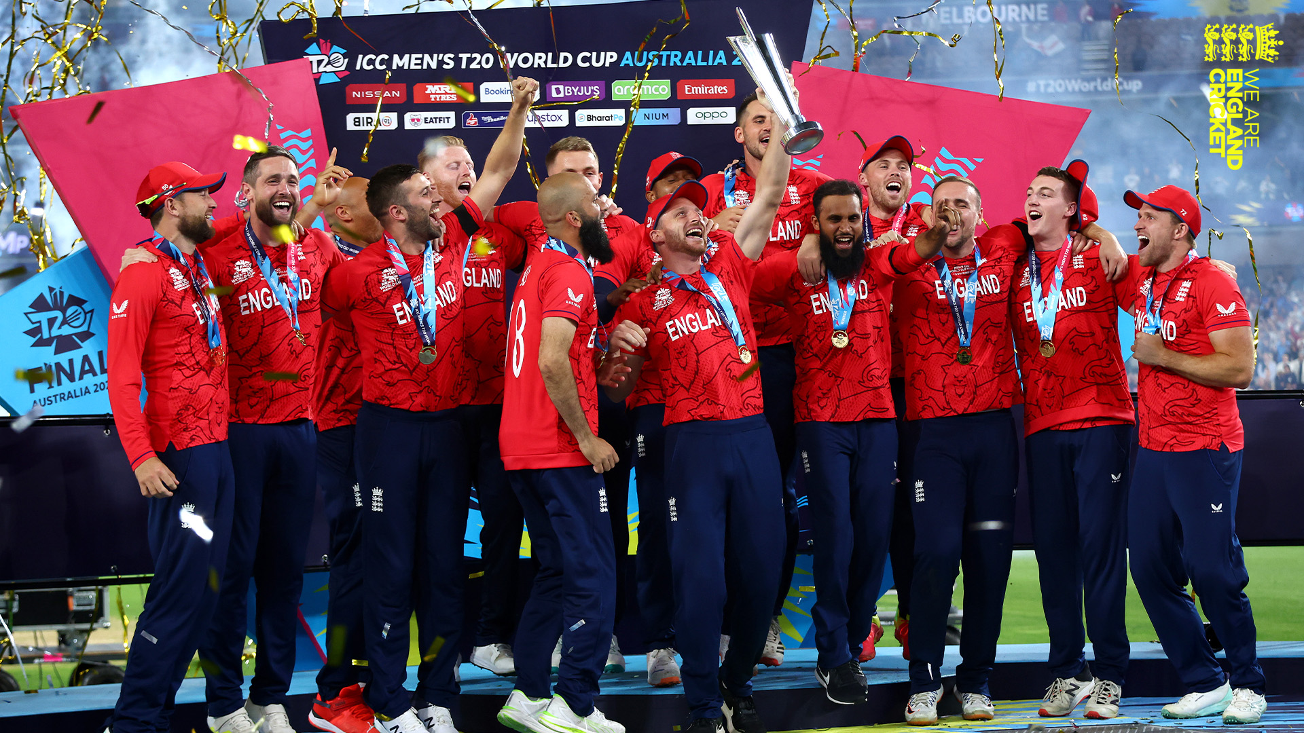
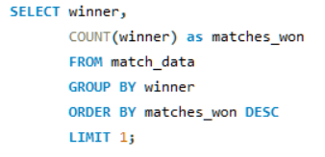
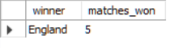
18. Team that won the most matches in a tournament

Slide 20
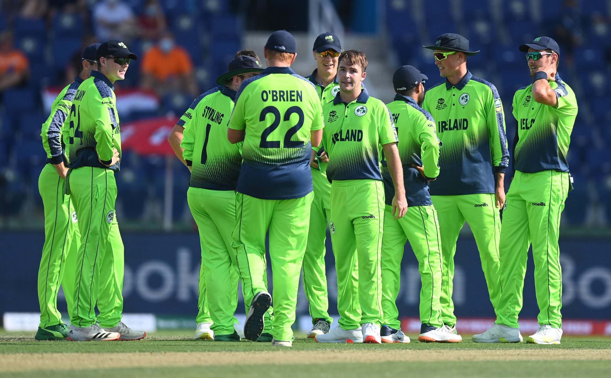
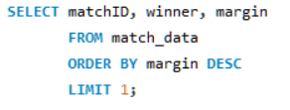
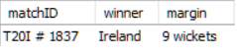
Highest margin of victory in the dataset

Slide 21



Number of matches won by a margin of fewer than 10 runs or 2 wickets

Slide 22

Thank You

